Slide 2
Learning objectives:
What is climate change?
What is CO₂?
What causes Climate Change?
What can we do to change it?

Slide 5
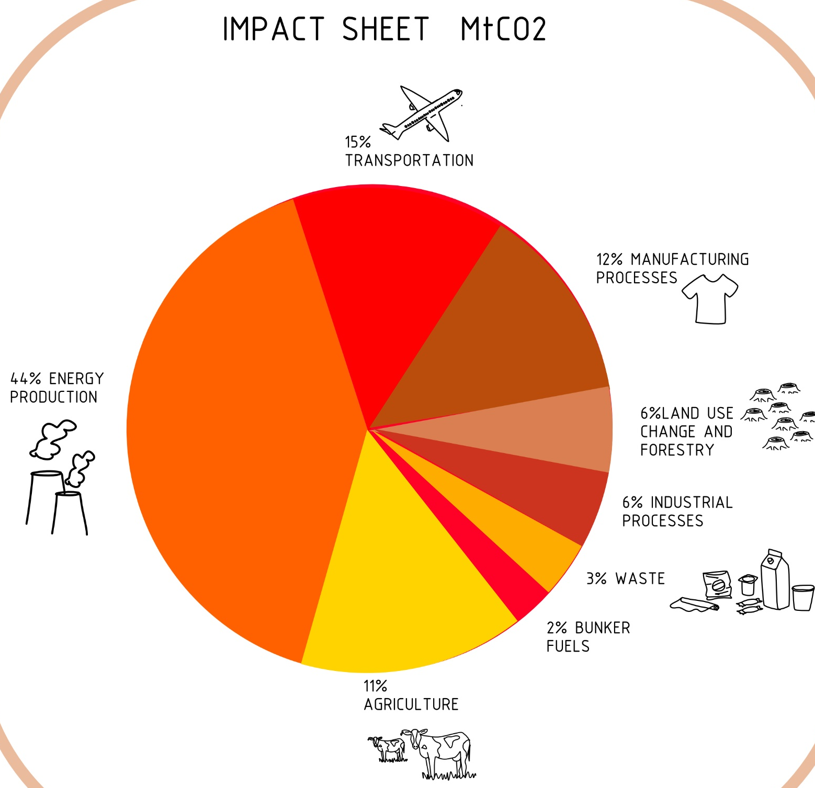

Slide 6
IT TAKES 10,000 LITRES OF WATER TO PRODUCE 1 KILO OF COTTON, MEANING IT TAKES ABOUT 2,700 LITRES TO MAKE 1 COTTON T-SHIRT. WHEN YOU BUY CLOTHING YOU THEREFORE “USE” WATER FROM WHEREVER THE COTTON WAS PRODUCED.
BY 2020 AIRPLANES COULD BE THE SINGLE BIGGEST CONTRIBUTOR TO GLOBAL WARMING.
MEAT IS VERY "INEFFICIENT" FOOD: MEAT HAS A MUCH HIGHER “ENERGY FOOTPRINT” THAN ANY OTHER FOOD. IT TAKES 75 TIMES MORE ENERGY TO PRODUCE MEAT THAN CORN. AND IT TAKES AN AREA OF VEGETATION 7 TIMES THE SIZE OF THE EU TO PRODUCE FOOD FOR THE CATTLE AND OTHER LIVESTOCK ANIMALS IN EUROPE
COAL PLANTS ARE DIRTY BUSINESS:
COAL PLANTS ARE INEFFECTIVE: ONLY 35 PERCENT OF COAL'S ENERGY (AT THE MOST) IS MADE INTO ELECTRICITY IN COAL-FIRED POWER PLANTS. THE REST IS LOST AS WASTE HEAT.
ARE MAJOR AIR POLLUTERS: BURNING COAL IS A LEADING CAUSE OF SMOG, ACID RAIN, GLOBAL WARMING, AND AIR TOXINS. THIS YEAR, AIR POLLUTION HAS CAUSED THE LOSS OF 12,267,414 YEARS OF HEALTHY LIFE WORLDWIDE.
USES UP FRESHWATER RESOURCES: A TYPICAL COAL-FIRED POWER PLANT USES MASSIVE AMOUNTS OF WATER TO CREATE STEAM FOR TURNING ITS TURBINES. ENOUGH WATER TO SUPPORT A CITY OF APPROXIMATELY 250,000 PEOPLE. AT THE SAME TIME, MANY AREAS IN THE WORLD IS RUNNING OUT OF FRESHWATER..
HALF OF THE WORLD’S RAINFOREST HAS BEEN DESTROYED IN JUST ONE CENTURY
ONE SINGLE PLASTIC BAG CAN TURN INTO 2 MILLION MICROSCOPIC PLASTIC FRAGMENTS. WE USE 160,000 PLASTIC BAGS A SECOND.

Slide 7
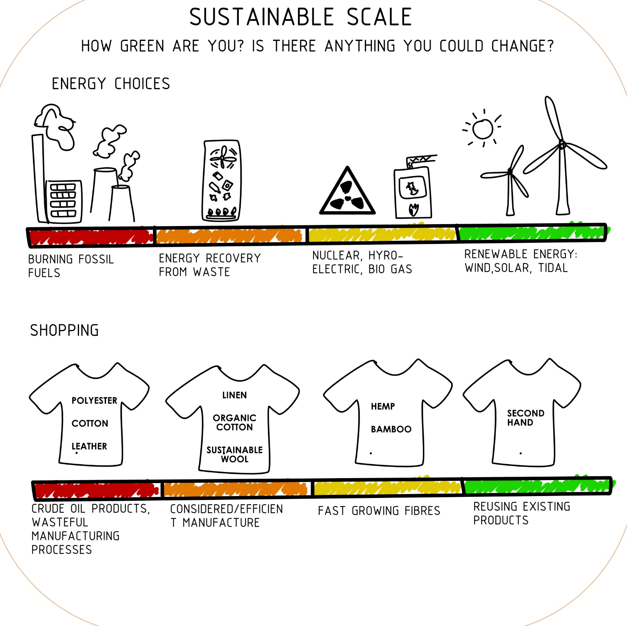

Slide 9
GOOD FOR THE EARTH? BAD FOR THE EARTH?
Card game :
Hand out the pack of cards and as the groups to sort them into tasks good for the planet and bad for the planet .
or in a large space read out the cards from the front and ask kids to run to the left for good for the earth and run right for bad for the earth. Last one to left or right, or the wrong way, is out.

Slide 11
EARTH PLEDGE CARDS

Slide 12
EARTH PLEDGE CARDS

Slide 13
EARTH PLEDGE CARDS

Slide 14
EARTH PLEDGE CARDS

Slide 15
Lesson conclusion:
Does the planet need our help?
Who can give me a reason the planet needs our help?
Do we all know what we can do to help?

Slide 17
“THE STONE AGE DIDN’T END BECAUSE WE RAN OUT OF STONE. IT ENDED BECAUSE IT WAS TIME TO RETHINK ABOUT HOW WE LIVE”
WILLIAM McDONOUGH

